Slide 1


Travel Geese Team

Slide 2
Today’s Presentation

Slide 3
Today’s Presentation
Problem statement

Slide 4
Today’s Presentation
Problem statement
Solution

Slide 5
Today’s Presentation
Problem statement
Solution
Value proposition

Slide 6
Today’s Presentation
Problem statement
Solution
Value proposition
Target audience

Slide 7
Today’s Presentation
Problem statement
Solution
Value proposition
Target audience
SWOT analysis

Slide 8
Today’s Presentation
Problem statement
Solution
Value proposition
Target audience
SWOT analysis
Market Opportunity (according to the PESTLE analysis)

Slide 9
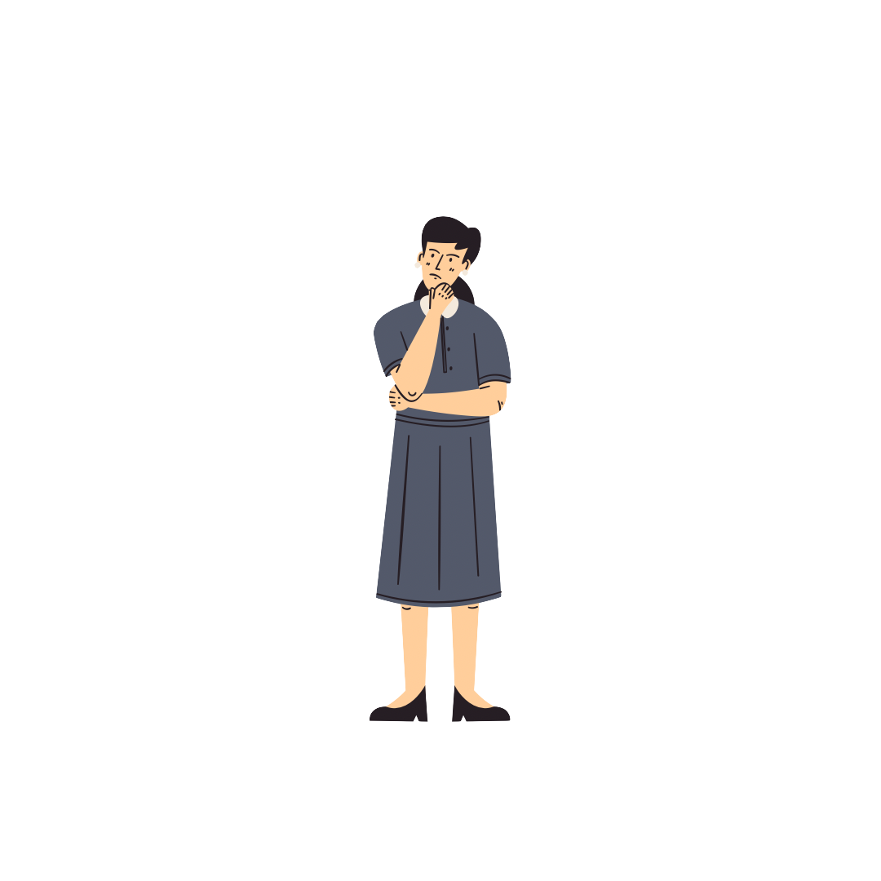
?
?
?
1. THE PROBLEM

Slide 10
?
?
?
1. THE PROBLEM
- Lack of personality and originality

Slide 11
?
?
?
1. THE PROBLEM
- Lack of personality and originality
- Increase influence of social media and its trends

Slide 12
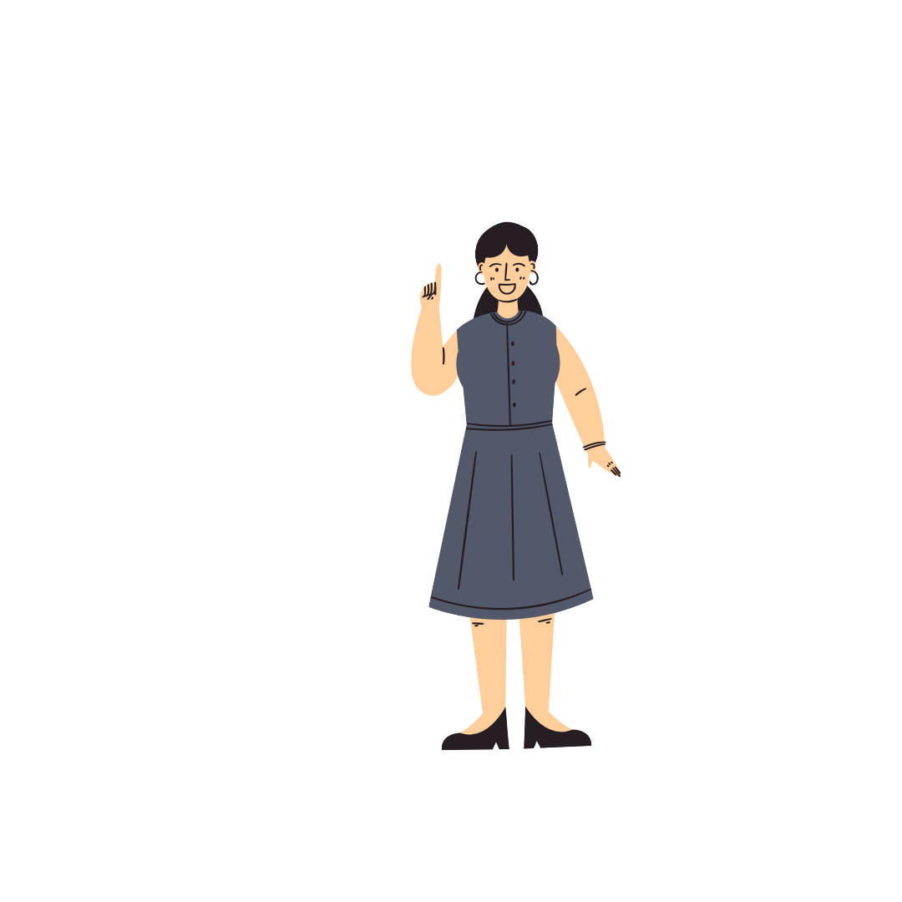

2. THE SOLUTION

Slide 13
2. THE SOLUTION
-Customizable travel bag

Slide 14
2. THE SOLUTION
-Customizable travel bag
-Express personal style and create something uniquely yours

Slide 15
2. THE SOLUTION
-Customizable travel bag
-Express personal style and create something uniquely yours
-Mission: “To provide an opportunity for your creativity to fly above the clouds.’’

Slide 16
2. THE SOLUTION
-Customizable travel bag
-Express personal style and create something uniquely yours
-Mission: “To provide an opportunity for your creativity to fly above the clouds.’’
-Vision: “To become the top travel leather goods luxury line by embracing uniqueness and authenticity”

Slide 17
3. VALUE PROPOSITION

Slide 18
THE TRAVEL GOOSE BAG

Slide 19
THE TRAVEL GOOSE BAG
- Complete customization : we elevate personalization to a new level

Slide 20
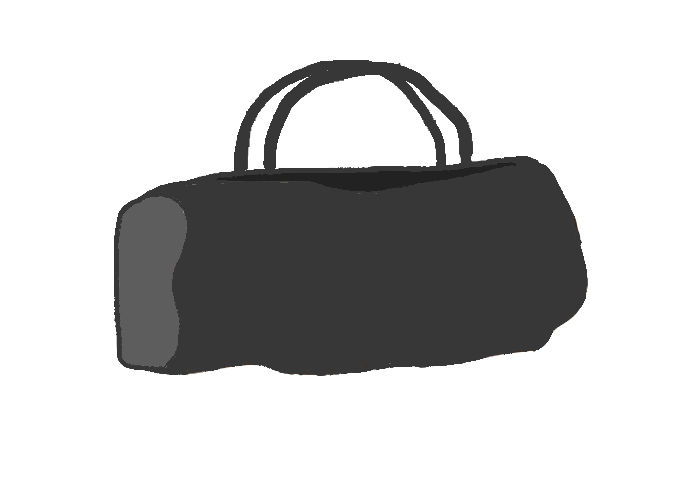
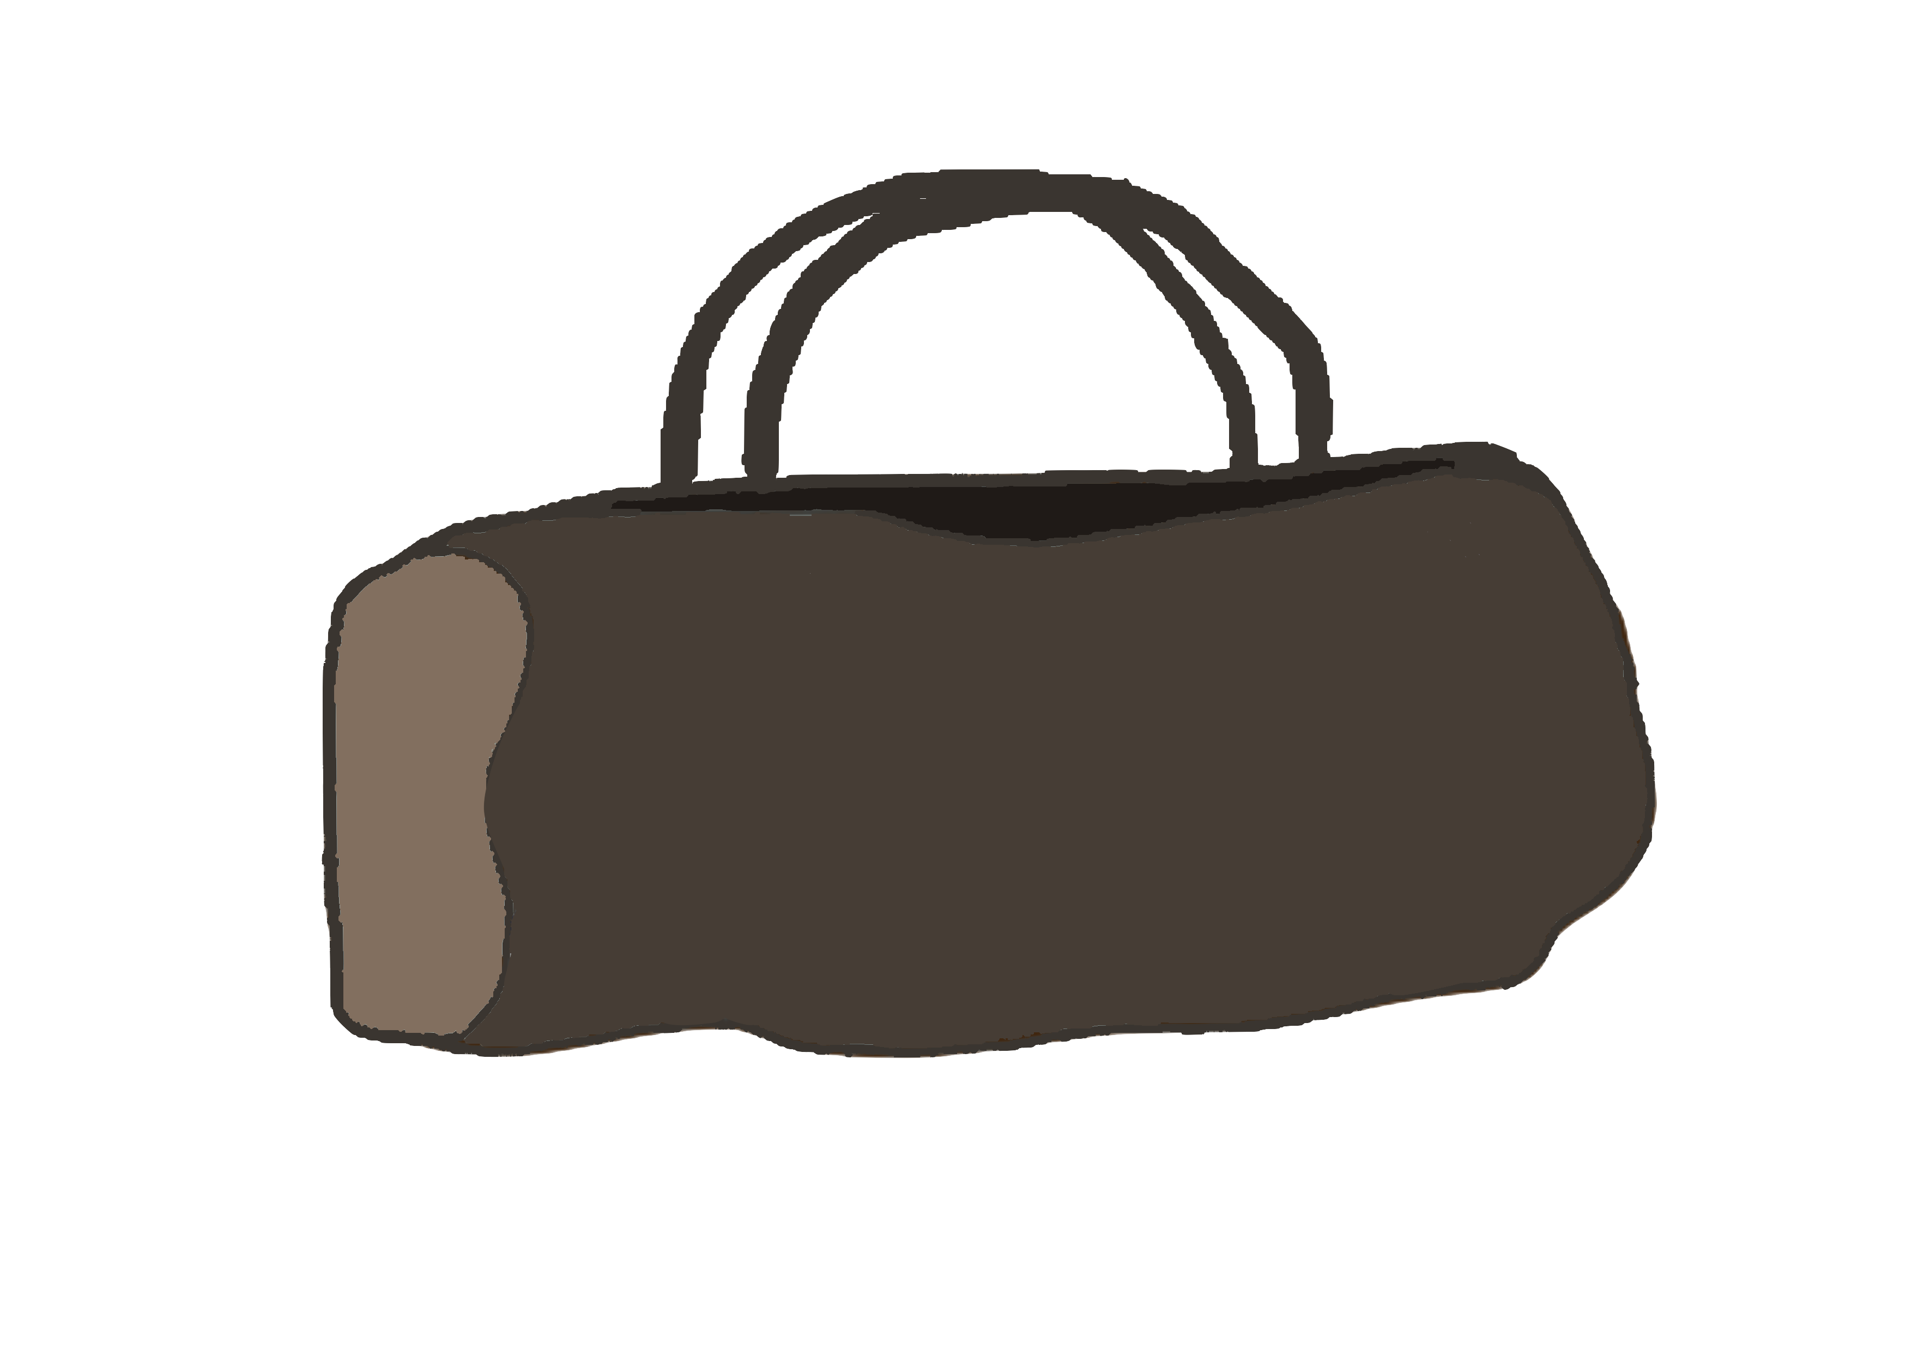
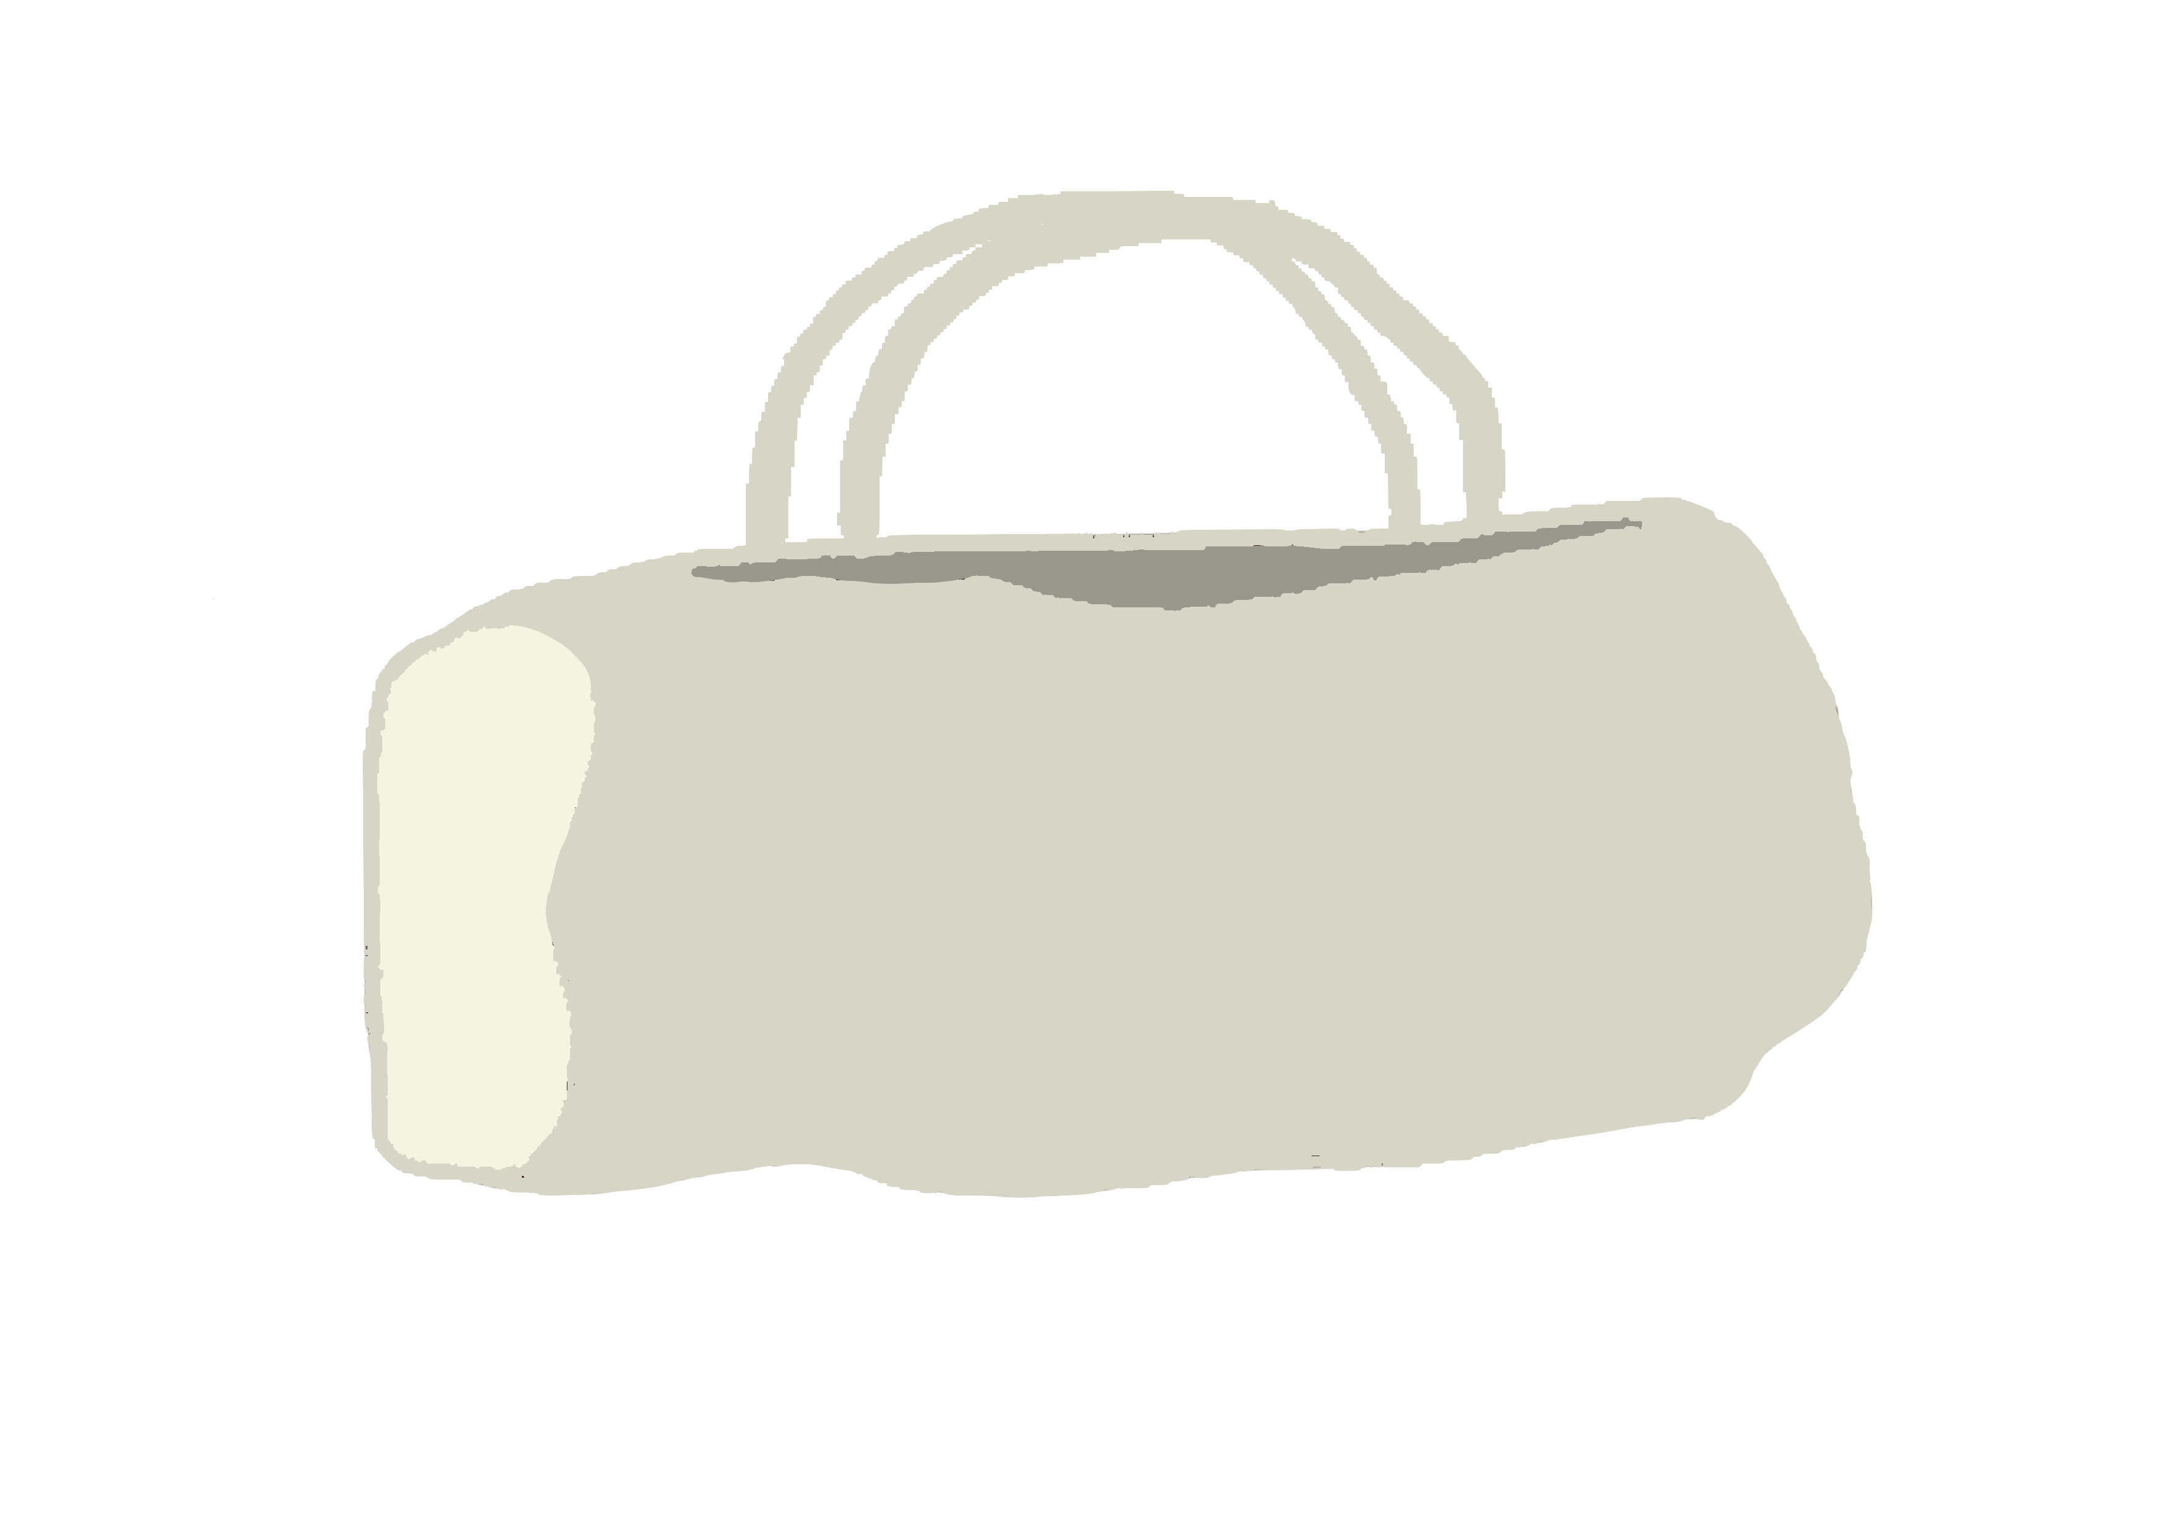
THE TRAVEL GOOSE BAG
- Complete customization : we elevate personalization to a new level

Slide 21
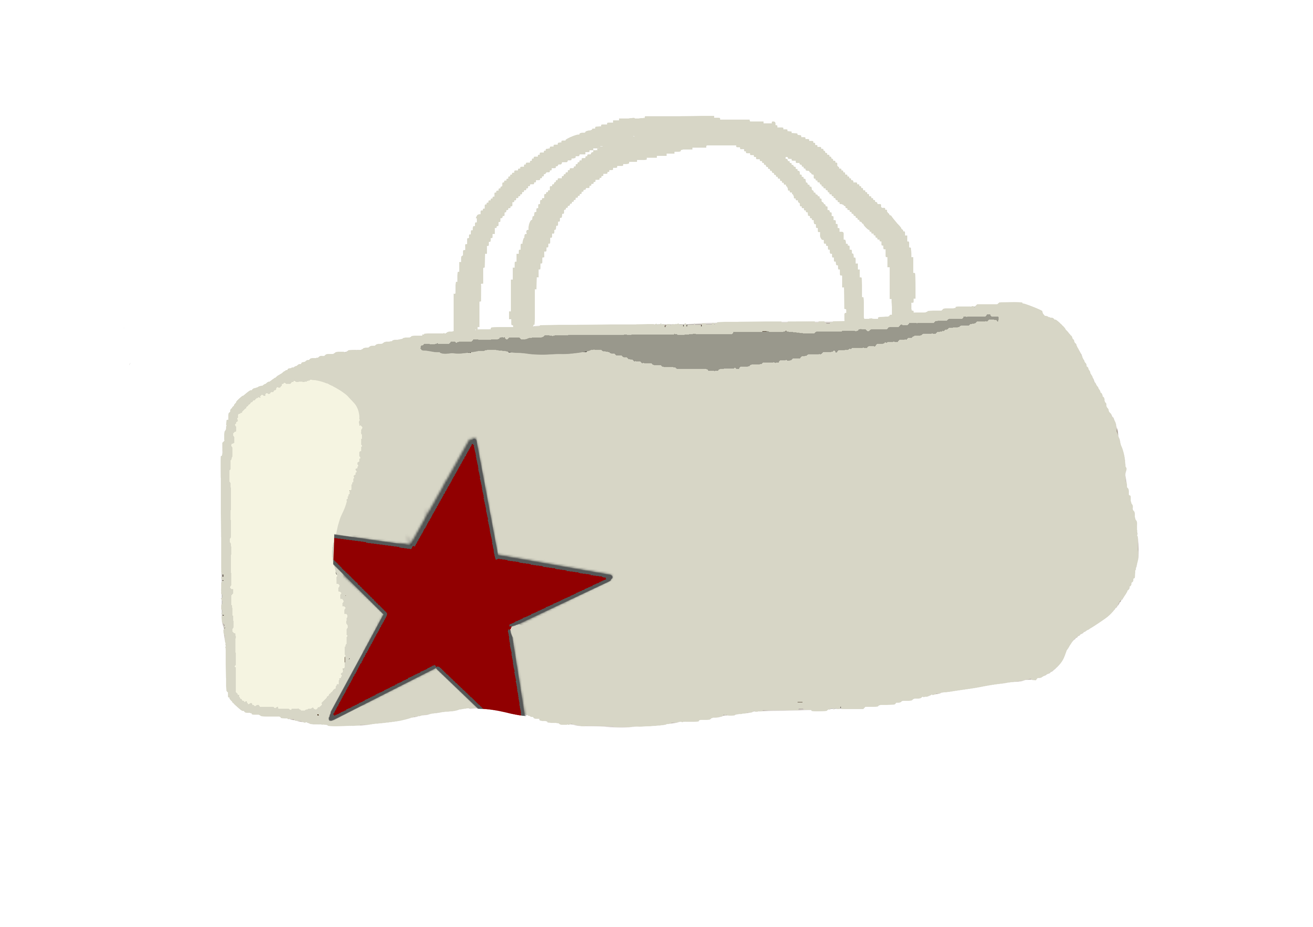
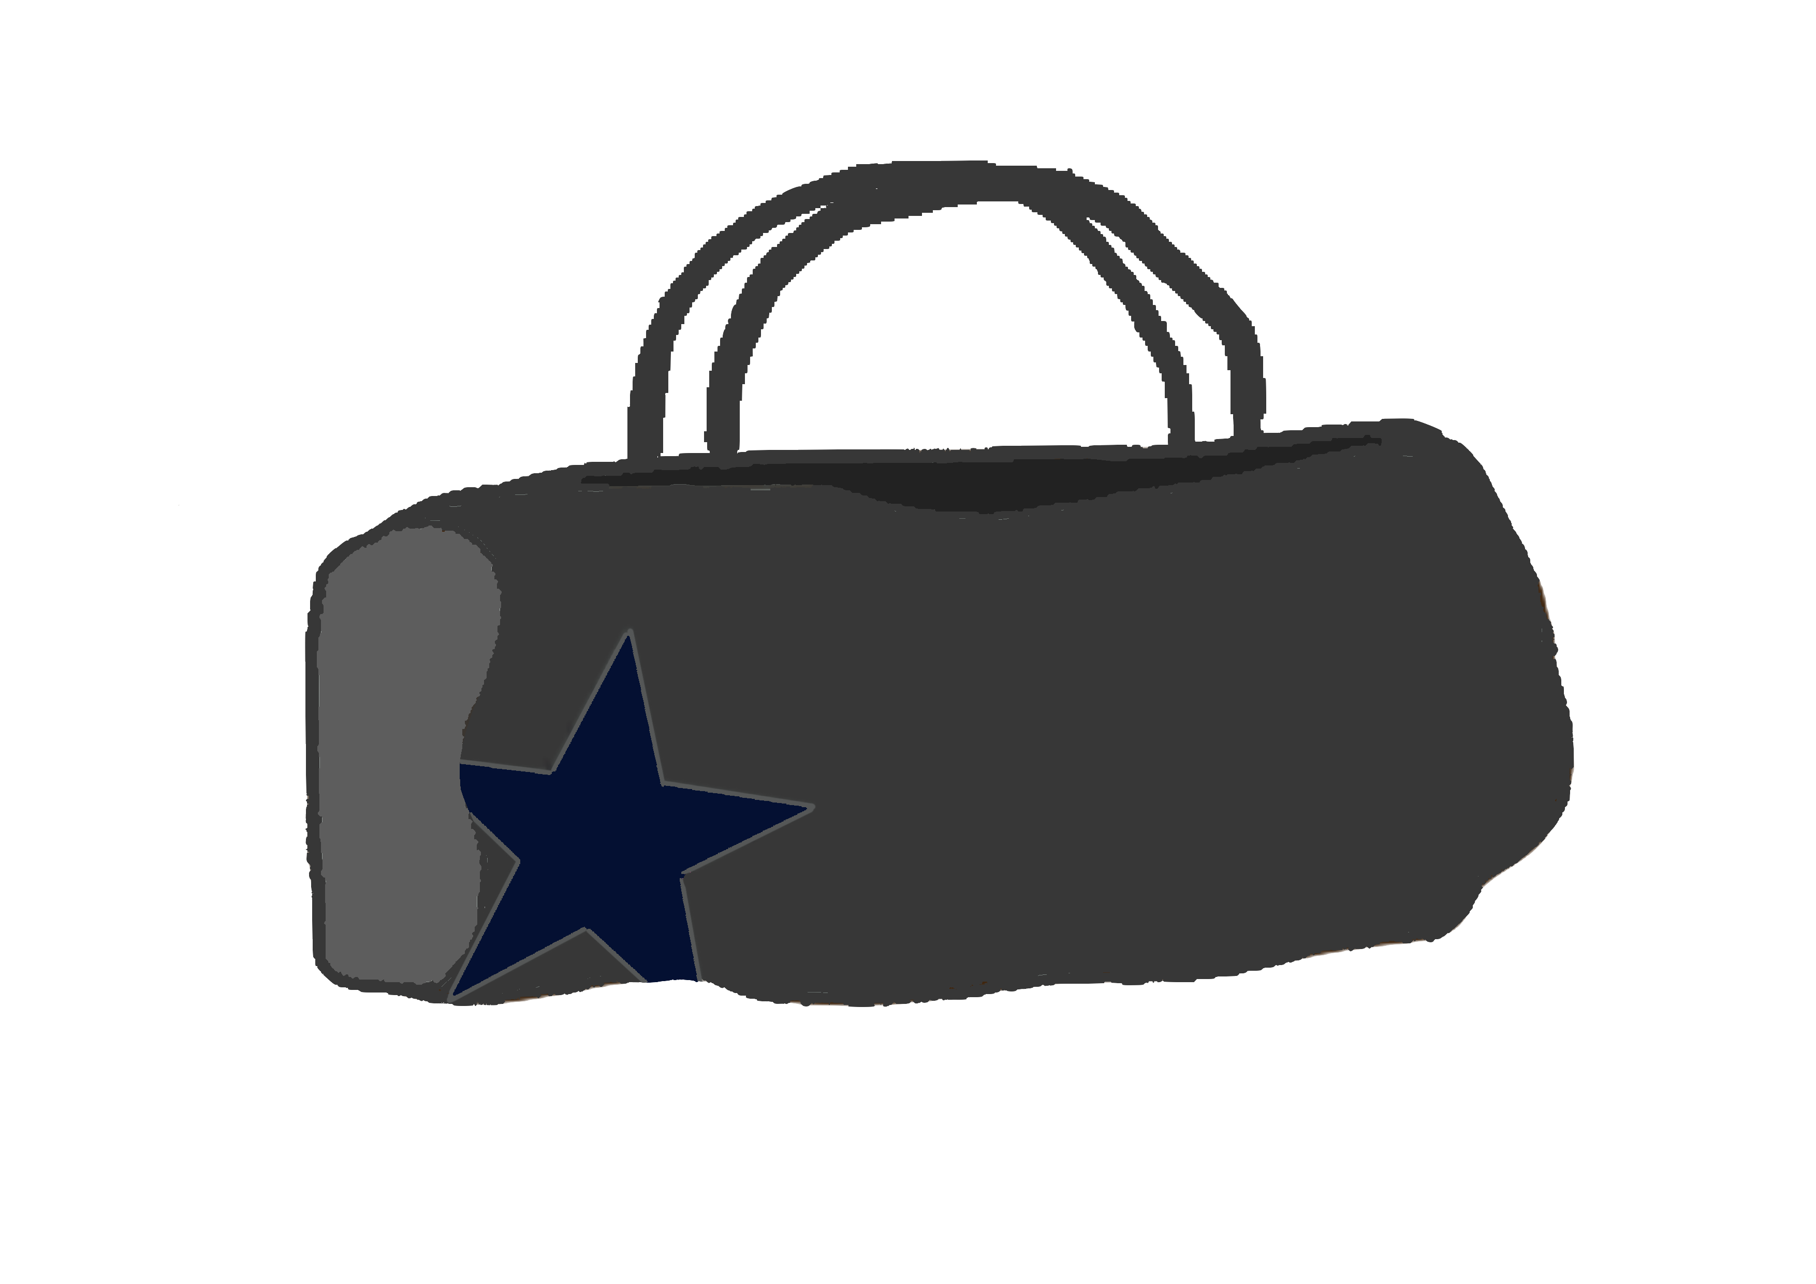
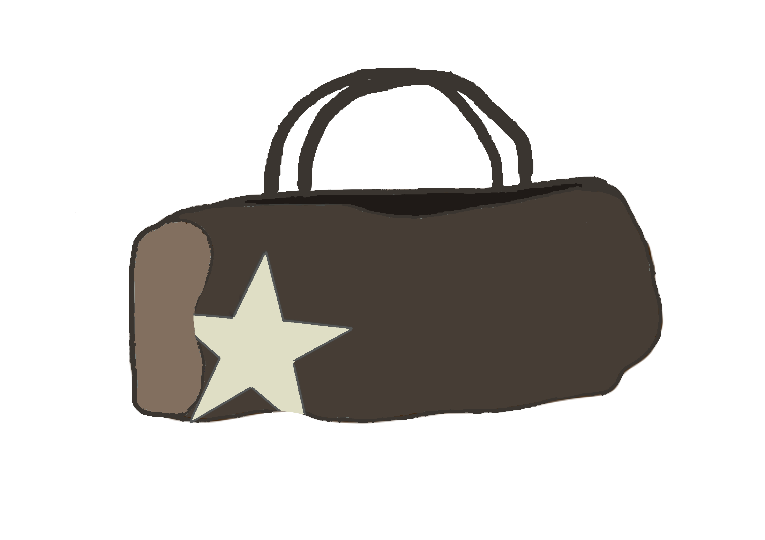
THE TRAVEL GOOSE BAG
- Complete customization : we elevate personalization to a new level

Slide 22
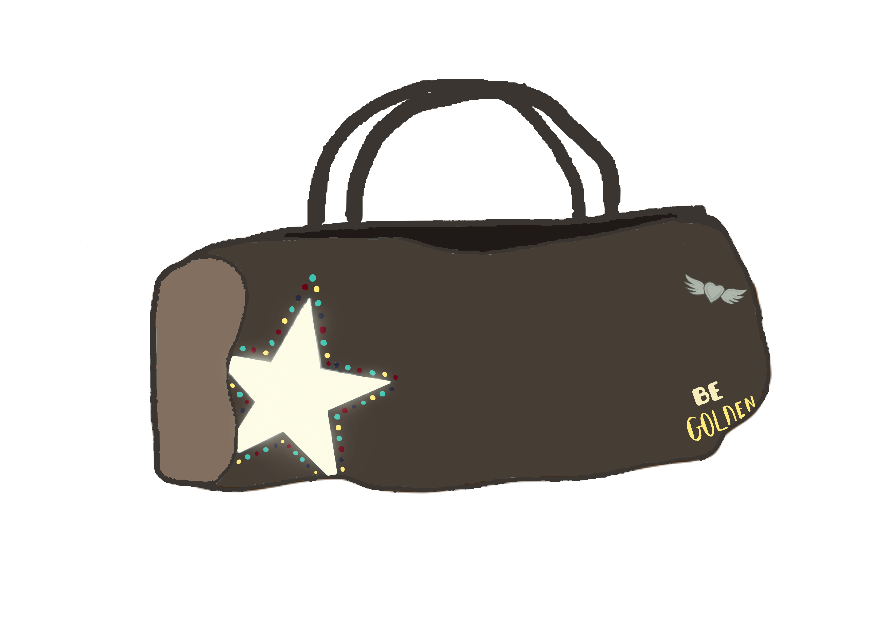
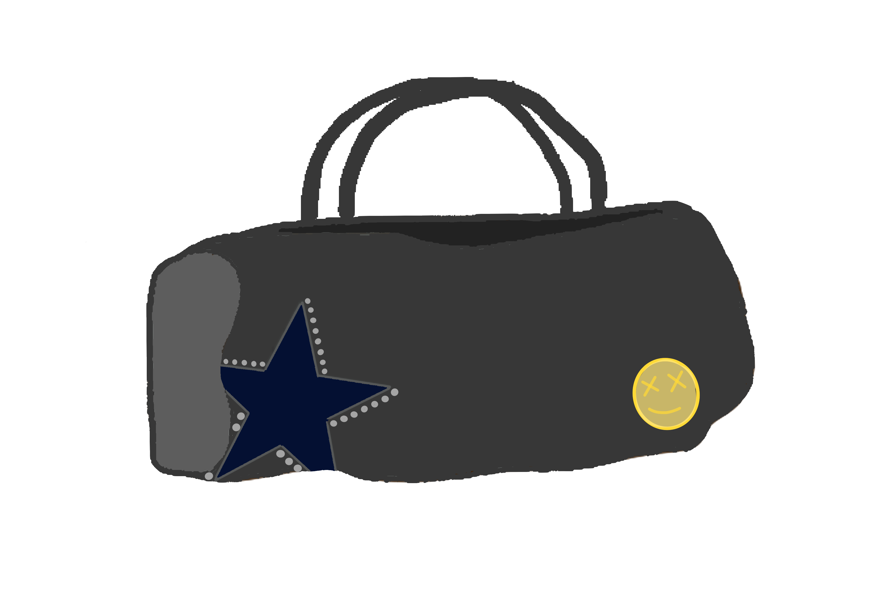
THE TRAVEL GOOSE BAG
- Complete customization : we elevate personalization to a new level

Slide 23
THE TRAVEL GOOSE BAG
- Complete customization : we elevate personalization to a new level
- In-store Artisery : Co-Creation Experience

Slide 24
THE TRAVEL GOOSE BAG
- Complete customization : we elevate personalization to a new level
- In-store Artisery : Co-Creation Experience
- True exclusivity

Slide 25
4. TARGET AUDIENCE

Slide 26



DEMOGRAPHIC AND GEOGRAPHIC

Slide 27
DEMOGRAPHIC AND GEOGRAPHIC
-All genders

Slide 28
DEMOGRAPHIC AND GEOGRAPHIC
-All genders
-Ages 18 to 50

Slide 29
DEMOGRAPHIC AND GEOGRAPHIC
-All genders
-Ages 18 to 50
-Educated and aware of the industry

Slide 30
DEMOGRAPHIC AND GEOGRAPHIC
-All genders
-Ages 18 to 50
-Educated and aware of the industry
-Urban and suburban areas

Slide 31
DEMOGRAPHIC AND GEOGRAPHIC
-All genders
-Ages 18 to 50
-Educated and aware of the industry
-Urban and suburban areas
-Top third income bracket in the Gini coefficient

Slide 32
PSYCHOGRAPHIC

Slide 33
PSYCHOGRAPHIC
-Frequent flyers

Slide 34
PSYCHOGRAPHIC
-Frequent flyers
-Willing to invest in high-end customizable products

Slide 35
PSYCHOGRAPHIC
-Frequent flyers
-Willing to invest in high-end customizable products
-Showcase their personality through fashion

Slide 36
BEHAVIORAL

Slide 37
BEHAVIORAL
-Hedonist luxury buyers

Slide 38
BEHAVIORAL
-Hedonist luxury buyers
-Seek gratification, pleasure and enjoyment

Slide 39
BEHAVIORAL
-Hedonist luxury buyers
-Seek gratification, pleasure and enjoyment
-Emphasis on immersive experiences and highlight craftmanship and quality

Slide 40
5. SWOT ANALYSIS

Slide 41
5. SWOT ANALYSIS
-Strength: '' Younique’’ + Golden Goose uses high quality materials

Slide 42
5. SWOT ANALYSIS
-Strength: '' Younique’’ + Golden Goose uses high quality materials
-Weakness: Our company has a limited product range

Slide 43
5. SWOT ANALYSIS
-Strength: '' Younique’’ + Golden Goose uses high quality materials
-Weakness: Our company has a limited product range
-Opportunity: By diversifying our products, we can reach out to a larger customer range

Slide 44
5. SWOT ANALYSIS
-Strength: '' Younique’’ + Golden Goose uses high quality materials
-Weakness: Our company has a limited product range
-Opportunity: By diversifying our products, we can reach out to a larger customer range
-Threat: High competition in the luxury industry

Slide 45
6. MARKET OPPORTUNITY
(according to the PESTLE analysis)

Slide 46
ECONOMIC FACTORS

Slide 47
ECONOMIC FACTORS
$ Bn
-In 2022, the market size was estimated at $22.7 billion, and it is expected to grow at a CAGR of 6.3% during the forecast period, reaching $37.1 billion by 2030.
CAGR: 6.3%
Growth of the global luxury handbag market

Slide 48
ECONOMIC FACTORS
$ Bn
-In 2022, the market size was estimated at $22.7 billion, and it is expected to grow at a CAGR of 6.3% during the forecast period, reaching $37.1 billion by 2030.
- In 2022, the leather material segment was quite lucrative in the global luxury handbag market.
CAGR: 6.3%
Growth of the global luxury handbag market

Slide 49
ECONOMIC FACTORS
$ Bn
-In 2022, the market size was estimated at $22.7 billion, and it is expected to grow at a CAGR of 6.3% during the forecast period, reaching $37.1 billion by 2030.
- In 2022, the leather material segment was quite lucrative in the global luxury handbag market.
-The demand for leather handbags is continually growing across the world since leather is a material which never goes out of style.
CAGR: 6.3%
Growth of the global luxury handbag market

Slide 50
TECHNOLOGICAL FACTORS

Slide 51
TECHNOLOGICAL FACTORS
-Augmented reality

Slide 52
TECHNOLOGICAL FACTORS
-Augmented reality
-Visualize and customize their bag s in real-time

Slide 53
CONCLUSION

